Slide 1

Tree-based Clustering of Longitudinal Data
Brianna Heggeseth, Ph.D.
Macalester College
Notes:
Good morning!
Thank you to Paul and the society for inviting me to speak to you this morning. Also, thanks for being awake and ready for talks at 8:30am.
Today, I’m going to talk about a project that I’ve worked on that involves adapting machine learning methods to address a public health question about childhood growth….
In particular, I’m interested in clustering longitudinal data, with repeated measures taken over time on hundreds of individuals, and I’ve taken a tree-based approach that I’ll explain as I go on.
CAUTION: not like other talks (no mixture models… no true labels to check performance)

Slide 2
Where I’m coming from
Williams College
Williamstown, MA USA
Small Liberal Arts Colleges
~2000 undergraduate students
Teacher-scholar model
Macalester College
St. Paul, MN USA
We are hiring!
Notes:
First, I want to tell you a bit of where I’m coming from.
For the past 6 years, I’ve been teaching at small liberal arts colleges in the States (only undergraduates --- 2000 students)
Teacher-Scholar Model (excellent, passionate teacher and stay active in your research)
Teach introductory statistics – to advanced electives in Data Mining, Correlated Data, Math Stats
Research I’m talking about today was done with an undergraduate senior at Williams for her thesis; she has now finished her first year of a PhD in Stats at Washington in Seattle
And we are hiring – so if you or someone you know is interested in a position that support innovative teaching and research, let’s chat!

Slide 3

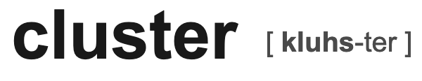
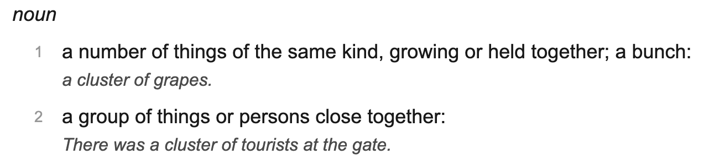
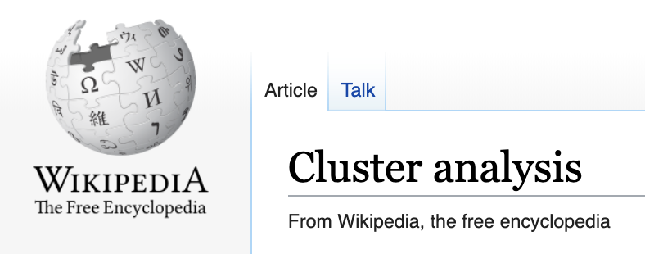
Notes:
So let’s start with clustering. Find clusters: a group of things of the same kind, ”growing together” or growing similarly….
And do so such that we get clusters of similar things and that the groups are dissimilar and distinct.
We’ll come back to similarity (in some sense)… implying that there some be many ways of defining similarity.

Slide 4

Clustering is vital
“Understanding our world requires conceptualizing the similarities
and differences between the entities that compose it.”
-Robert Tryon and Daniel Bailey, 1970
Notes:
I probably don’t have to convince this crowd that clustering is vital.
But I’m not just talking about it in the statistical sense. But in the way our minds are constantly clustering….
To synthesize a lot of information, we simplify life by detecting patterns and consider categories, rather than individuals.
How we learn from infancy is based on perceptual similarity… It makes us human and allows us to take in new information…
I watch my 3 year old daughter categorize and cluster a variety of things over the years (blocks can be grouped by color or shape or size…) Right now, she is into grouping everyone into one of two groups: “boys” and “girls”
We are currently teasing out gender and sex and the difference between what we perceive and an individual’s gender identity. It is complicated to explain it to a 60 year old, let alone a 3 year old. So it is easier to just think “boys” and “girls” but….

Slide 5

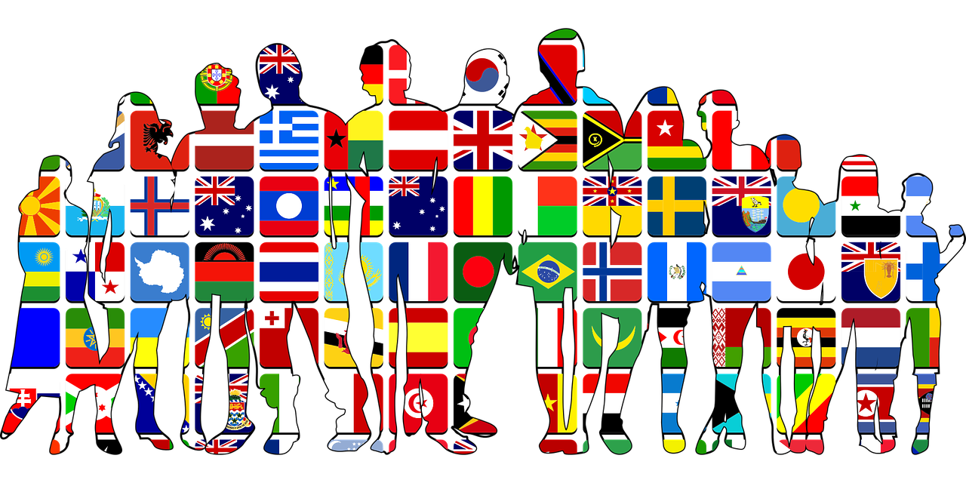
Clustering is an imperfect tool
Focusing on the group summary can mask individual variation
Notes:
These two categories don’t quite suffice. They mask individual variation
As with any method, we should be concerned about the limitations of a method and human and ethical implications of them. So when we cluster, we are finding things that are similar, but it can be dangerous to focus solely on the group summary as it can mask individual variation ----
In our daily lives, for better or worse, we categorize people by perceived gender, race, nationality, class, hobbies. Those can be useful categorizations to understand the world but they also fuel stereotypes and imperfect inferences about an individual based on a group.
No one clustering/categorization is correct and absolutely true.
Let’s keep this in the back of our mind as we go forward.

Slide 6
Standard Cluster Analysis Methods
Dissimilarity-Based Algorithms
K-means
Partitioning around Medoids
Hierarchical Clustering
Model-Based Clustering
Mixture Models
More…
Notes:
In an undergraduate course, you’d learn some of the basic approaches to cluster analysis methods.
We all know there are many methods out there…. I put this up to make it clear what I am referring to standard methods.
What they all have in common is that they all explicitly or implicitly define similarity between individuals…..

Slide 7
Which are similar?
Notes:
Let’s transition to thinking about longitudinal data, repeated measures over time on a group of individuals. I’m simplifying it to lines for the moment.
5 lines, which are similar? How do you define the similarity? You don’t need to shout out… just think in your mind.
Our brains are so good at this type of thing.

Slide 8
Which are similar?
Notes:
You may have grouped them like this…
Positive slope..
Negative slope…
stable

Slide 9
Which are similar?
Notes:
You may have grouped them like this…
High, Middle, Low levels
Both level and slope are important

Slide 10
Which are similar?
Notes:
If you focus on just one value of x (cross-sectional study), you may have grouped them like this…
Only considering the value at x = 10, ignoring the rest of the line

Slide 11
Which are similar?
Notes:
If you focus on just one value of x (cross-sectional study), you may have grouped them like this…
Only considering the value at x = 0, ignoring the rest of the line

Slide 12
Which are similar?
Notes:
Over 300 children and their BMI from about age 2 to about 15/16 years old
It isn’t so straightforward.
Maybe we can translate some of the ideas from the simplified lines to these non-linear trajectories….
We could consider children at a particular age….
What I notice is that as they age, the variability in their BMI increases… So if we look at this data cross-sectionally at a variety of ages, we might not detect any useful clusters until age 14….
Or we could see that that some have generally high BMI throughout childhood and others have much lower BMI’s…
But we may also wonder about whether there are some of those children who have higher BMI… whether they might be relatively stable over time or increasing over time.. The same goes for those with lower BMI…

Slide 13

Motivating Data
Notes:
Salinas Valley, California
The salad bowl of United States

Slide 14
CHAMACOS Study
Longitudinal birth cohort study
601 pregnant Latina women recruited in agricultural Salinas Valley, CA in 1999-2000
Data on mother and child pairs every 1.5-2 years
(irregular, unbalanced data)
Measured child physical characteristics over time, chemical concentrations in maternal blood and urine during pregnancy, maternal demographics

Slide 15

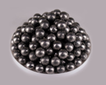


Public Health Hypothesis
In-utero exposure to endocrine disrupting chemicals may reprogram metabolic systems and cause later obesity (Braille-Hamilton 2002)
Industrial
Chemicals
(BPA, plasticizers)
Pesticide
Herbicide
Fungicide
Personal care
products
Metals
(lead, mercury)

Slide 16
CHAMACOS Study
Growth outcome: Child body mass index (kg/m²) over time
Exposures: Maternal phthalate metabolite urine concentrations during pregnancy (11 metabolites)
Covariates: Child birth weight, maternal pre-pregnancy BMI, age, number of years in the US, education, marital status, breastfeeding, diet quality, smoking status during pregnancy

Slide 17
BMI Trajectories

Slide 18
Research Question
Is there an association between any of the 11 maternal phthalate metabolite concentrations and the BMI development over time,
accounting for potential maternal factors
and co-pollutant confounding?

Slide 19
Statistical Questions
How do we define similarity between children?
Do we focus on BMI level or growth pattern over time?
How should we deal with correlated metabolite concentrations?
Growth is non-linear. Association with exposures may be non-linear (non-monotonic dose response).

Slide 20
Notation
Let be an outcome vector measured at observation times .
We assume the outcome is generated from a smooth underlying function of time, .
Let be a vector of baseline variables.

Slide 21
Similarity
Vector-based dissimilarities cannot be applied directly to raw data due to irregular, unbalanced vectors, .
Dissimilarities can be used if we can estimate non-linear functions, .

Slide 22
Splines
Estimate individual smooth BMI trajectories with piecewise polynomials of degree d
Break up the time axis into intervals by placing knots at the interval endpoints
Fit a different polynomial within each interval
Notes:
Consider removing

Slide 23
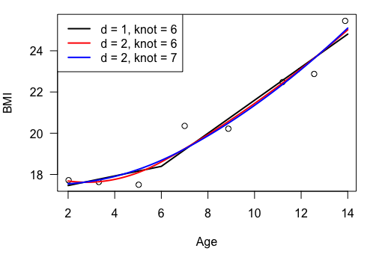
Splines
Notes:
Choosing the degree and the knots is not trivial, especially if you have some individuals with few data points…
You need to choose one basis that can accommodate
You can fix degree first and then try a variety of knots --- pick one that minimizes the sum of squared errors across the individuals

Slide 24
B-Splines
B-splines are spline functions that can be written as linear combination of basis functions, B_{k,d}(t), with some “nice” properties (continuous function and derivatives)

Slide 25
Similarity Measure
Distance between function values on a grid of times
Distance between coefficients (Abraham et al 2003)
Notes:
Evaluate the basis on grid of times and organize them into B matrix….
Similar only if the basis is orthonormal, which won’t be the case with standard B-splines basis
We have stuck with the first one because it is more interpretable… looking at the difference between the smooth trajectories

Slide 26
Standard Partition Clustering Process
Group 1
Group 2
Group 3
Notes:
Now that we have some ideas for similarity….
Let me use a simple example to illustrate
With the right dissimilarity measure and a partition clustering algorithm, we might group these nine trajectories into three groups that are homogenous in terms of shape over time….

Slide 27
Group Association with Exposures
Mean Baseline Exposure Values within Groups
 | w1 | w2 | w3
Group 1 | 2.3 | 1.1 | 5.3
Group 2 | 1.6 | 1.3 | 2.3
Group 3 | 0.5 | 0.9 | 1.1
Notes:
Then, following the hard clustering, we could do an ad-hoc analysis looking at the distribution of the exposure value within each group….
We see that for both the first and third exposure, denoted W1 and W3, group 1 has higher values on average than group 2 or even group 3. There is not as much variation in W2 across these groups.
Of course, with model-based clustering, we could include these exposure values in a model for membership probabilities, but
In practice, I’ve had trouble with model complexity being too large when considering 20 or more baseline exposures…. And also know the right functional form for some of these variables and whether there should be interactions or not…

Slide 28
Notes:
Then, following the hard clustering, we could do an ad-hoc analysis looking at the distribution of the exposure value within each group….
We see that for both the first and third exposure, denoted W1 and W3, group 1 has higher values on average than group 2 or even group 3. There is not as much variation in W2 across these groups.
Of course, with model-based clustering, we could include these exposure values in a model for membership probabilities, but
In practice, I’ve had trouble with model complexity being too large when considering 20 or more baseline exposures…. And also know the right functional form for some of these variables and whether there should be interactions or not…

Slide 29
Another Clustering Option
Tree-based Clustering
Divide baseline exposure variable space so as to create groups homogenous in terms of the outcome
w3
l1
l2
w1

Slide 30
Tree-based Clustering
Root Node
All Data
w3 ≤ l1
w3 > l1
w1 ≤ l2
w1 > l2
Leaf Node
Leaf Node
Leaf Node

Slide 31
Regression Trees
Classification and Regression Trees (Breiman et al. 1984)
Recursively partition covariate space in two by choosing
a variable and
a place to split to optimize a split criterion
Exhaustive search through all possible two-way splits

Slide 32
Split Criterion
Standard univariate data: Choose variable and split to create regions that minimize
Notes:
For longitudinal data, We can’t just make these vectors because they aren’t observed at the same times

Slide 33
Split Criterion
For longitudinal data: Choose variable and split to create regions that minimize
Notes:
So we use our estimated smooth functions
Where the average function can be found by averaging the spline coefficient vectors within the node….

Slide 34
Why use Trees?
Can accommodate many predictors without specifying the functional relationship (including interactions)
Becoming more popular for univariate environmental epidemiology exploratory research (Venkatasubramaniam et al 2017, Gass et al 2014, Billionnet et al. 2012)
Creates homogenous sub-populations of the data (like standard cluster analysis)

Slide 35
SplineTrees
To focus on the development over time, we can eliminate the level and split only based on variability in shape of function over time
Wrote custom split functions for rpart() in R
splinetree R package on CRAN
install.packages(‘splinetree’)

Slide 36
SplineTrees
With Intercept Included

Slide 37
SplineTrees
Boys: With Intercept

Slide 38
SplineTrees
Girls: With Intercept

Slide 39
SplineTrees
Without Intercept

Slide 40
SplineTrees
Boys: Without Intercept

Slide 41
SplineTrees
Girls: Without Intercept

Slide 42
Why Not Trees?
One single tree does not provide full information
Splits optimize locally, not globally
Consider random forest to overcome greediness of the algorithm

Slide 43
Why Not Trees?
CART algorithm is known to favor variables with more unique values
Alternatives are available for unbiased variable selection with univariate outcomes (ctree, cforest)
First pick variable, then pick split conditional on variable

Slide 44
SplineForests
Create bootstrap sample
Fit a splinetree with random variable selection
Repeat
Measure variable importance as the average amount the predicted outcome changes when reshuffle values of the variable

Slide 45
SplineForests
Notes:
ADD sex—specific versions

Slide 46
SplineForests
Notes:
ADD sex—specific versions

Slide 47
SplineForests

Slide 48
SplineForests

Slide 49
Other Longitudinal Tree Methods?
REEMtree/MERT (Hajjem et al 2011, Sela and Simonoff 2012)
Tree for fixed effects, global random effects
Clusters individual observations, not trajectories
LongRPart/MODERN (Stewart and Abdolell 2013, Simonoff and Larocque 2015)
Mixed effects model within each node
Random effects absorb most variability
Notes:
In simulations and on real data, Splinestrees work the best at capturing associations with change over time.

Slide 50
Conclusions
New method provides clusters based on outcome development over time as well as baseline exposures
Exploratory tool to motivate further research
Carefully consider similarity in the context of the problem

Slide 51
Future/Current Work
Clustering Categorical Longitudinal Data
Data: sleep stages, health care utilization of patients
Methods:
Mixture of Markov Models (but what if the starting dynamics aren’t the same as the end)
Dissimilarities that capture temporal ordering, allow for differently lengths but aren’t solely driven by length of trajectory

Slide 52


Thank you!
Williams Science Center for funding
Williams Students
Kiran Kumar ’18
- Broad Cancer Genomics Scholars
Anna Neufeld ’18
- U. of Washington Stats PhD
Contact me: bcheggese@macalester.edu

Slide 53
Selected References
Baillie-Hamilton PF (2002). Chemical toxins: a hypothesis to explain the global obesity epidemic. J Altern Complement Med 8(2):185-92.
Billionnet C, Sherrill D, Annesi-Maesano I (2012). Estimating the health effects of exposure to multi-pollutant mixture. Ann Epidemiol 22(2):126-41.
Breiman, L., Friedman, J., Olshen, R. A., & Stone, C. J. (1984). Classification and regression trees. Chapman and Hall/CPC.
Eo, S. And Cho, H. (2014), Tree-Structured Mixed-Effects Regression Modeling for Longitudinal Data. Journal of Computational and Graphical Statistics 23(3).
Gass K, Klein M, Chang HH, Flanders WD, Strickland MJ. (2014) Classification and regression trees for epidemiologic research: an air pollution example. Environ Health 13(1):17.
Larocque, D. and Simonoff, J.S. (2015), Model-Based Mixed Effects Trees for Longitudinal and Clustered Data, Proceedings of the 30th International Workshop on Statistical Modelling, Volume 1, Linz, Austria, 279-284.
Ogden CL, Carroll MD, Fryar CD, Flegal KM. (2015). Prevalence of obesity among adults and youth: United States, 2011–2014. NCHS data brief, no 219. Hyattsville, MD: National Center for Health Statistics.
Segal, M (1992). Tree-Structured Methods for Longitudinal Data. Journal of the American Statistical Association 87(418).
Venkatasubramaniam A, Wolfson J, Mitchell N, Barnes T, JaKa M, and French S (2017). Decision trees in epidemiological research. Emerging Themes in Epidemiology 14(11).
Yu, Y. and Lambert, D. (1999), Fitting Trees to Functional Data, with an Application to Time-of-Day Patterns, Journal of Computational and Graphical Statistics, 8(4)

